Slide 1
The Document Object Model
Class 1

Slide 2
Sample Model
You can imagine an HTML document as a nested set of boxes. Here’s an example document
<!doctype html> <html> <head> <title>My home page</title> </head> <body> <h1>My home page</h1> <p>Hello, I am Marijn and this is my home page.</p><p>I also wrote a book! Read it <a href="http://eloquentjavascript.net">here</a>.</p> </body> </html>

Slide 3
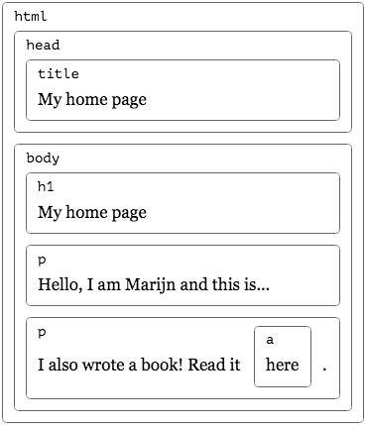
Sample Model
.

Slide 4
The DOM
The data structure the browser uses to represent the document follows this shape. For each box, there is an object, which we can interact with to find out things such as what HTML tag it represents and which boxes and text it contains. This representation is
called the Document Object Model, or DOM for short.
The global variable document gives us access to these objects. Its
documentElement property refers to the object representing the <html> tag. It
also provides the properties head and body, which hold the objects for those
elements.

